Slide 1

We Will Begin Shortly

Slide 2

Introduction to Reinforcement Learning Workshop
Brought to you by:
Tyler Jackson, Haley Dozier, William, Jo Jabour

Slide 3
Please Ensure the Following:
You have an IDE ready to use that can interpret Python 3.7 or higher
You have Python 3.7 or higher downloaded on your machine
You have admin rights on your machine and can download packages onto it
The outlets at your table work (if needed for computer charging, etc.)
We will have more time during the workshop to ensure everyone is ready to start
WE WILL BEGIN SHORTLY

Slide 4
Meet the Instructors, Collaborators, and Speakers
Instructor: Tyler Jackson
Collaborators: Joshua Church, Thomas Clement, ADD MORE
Speakers:
Haley Dozer - experience
William - experience
Joseph Jabour - experience

Slide 5
Objectives for RL Workshop
Become familiar with common Reinforcement Learning (RL) Algorithms and methods
Understand the fundamentals of RL and how to apply it for various scenarios
Comprehend the development of RL algorithms so that you can shape them to specific niche cases
Obtain hands-on experience with RL with a coding project and apply all methods taught in workshop to a common goal
Learn about real-world applications of the field and gain inspiration for future endeavors

Slide 6
Workshop Setup Details
Debugging Breaks and Breaks:
Debugging breaks are for either taking a mental break or collaborating to debug code with leaders
Breaks will be for rest. No leaders will be available to help debug during these times.
Theory and Application:
We will walk through the process and theory behind all algorithms first. Afterward we will be sure to apply all theory in a concise manner. Equal time will be spent between these two parts.

Slide 7
Mission:
Learning heavy materials can be overwhelming.
With the help of a few of the workshop collaborators, we have decided to teach these complex methods using a simple problem: Tic-tac-toe
All algorithms will be applied toward a Tic-tac-toe game
You will be able to play against the algorithm and models developed with a GUI

Slide 8
What We Will Learn:
Q-Learning Algorithms
Reward shaping
Q-Tables
Expert Data and Algorithms
Minimax Algorithm
Deep Q-Networks
Q-Learning Update Rule
DQN Equation
Deep Q-Learning from Demonstrations
Combining Expert Data and DQNs

Slide 9

Please Welcome Haley Dozer!

Slide 10

Thank You, Haley Dozer!

Slide 11
Coding Environment Setup
Ensure all requirements from earlier in our setup are met
Pip install Torch to the Python version you will be using today
Test torch works with code below:
import torch
print(torch.__version__)
We will take the next 30 minutes to ensure everyone is ready to proceed

Slide 12
The Forefathers of Reinforcement Learning
Richard Bellman 1950s- introduced the concept of dynamic programming and Markov Decision Processes (MDPs), which are foundational to modern RL.
Michael Lvovitch Tsetlin 1960s– created concept in computer science coined “learning automata.”
Richard Sutton and Andrew Barto (1992) – popularized Reinforcement Learning in the textbook "Reinforcement Learning: An Introduction”
Often credited as the two of the top contributors to the field of RL

Slide 13
What is Reinforcement Learning?
A branch of Artificial Intelligence that allows you to train a model based on a reward system
The goal is to create some agent that will learn optimal decision-making strategies based on whether it gains or loses points.
Rewarding an agent negative points will discourage a given decision
Rewarding an agent positive points will encourage a given decision
The agent will experiment in many different states/scenarios
It will then make all possible moves to determine which decision is best and worse to make given a specific state

Slide 14
What is Reinforcement Learning? (cont.)
The agent will interact with an external environment and generate a model or data from its decision-making process that can be either stored for later use
An agent will typically try to balance exploration with exploitation after it has garnered enough data to do so
Exploitation limits the consideration of new decision-making processes
Exploration can limit the optimization of a decision-making process within a given system
We will explore all aspects of this throughout the workshop and strike a balance between exploitation and exploration!

Slide 15
Applications of Reinforcement Learning
Autonomous vehicle
ADD VIDEO HERE

Slide 16
Applications of Reinforcement Learning (cont.)
ADD PICTURES HERE

Slide 17

10 Minute Break

Slide 18
Introduction to Q-Learning
Q-learning: a model-free reinforcement learning algorithm to learn the value of an action in a particular state.
Key Concepts:
State: s, the current environment the agent encounters
Action: a, a given decision the agent can make in a particular state
Q-Value Function: Q(s,a), gives the expected reward value given a state and action
Objective: Optimize long-term cumulative rewards based on Q-Value function

Slide 19
Q-Learning Algorithm Goals:
Initialization:
Iterate over Q(s,a) arbitrarily for all state-action combinations (s,a)
Exploration and Exploitation:
Strike a balance between exploration (trying new actions) and exploitation (taking actions with the highest Q-value)

Slide 20
Q-Learning Update Rule
Goal:
To update Q(s,a) based on the observed reward r and the maximum expected future reward from the next state s′
Q-Learning Update Function:
Q(s,a) ← Q(s,a)+α [r+ γ′ maxa ​Q(s′,a′) − Q(s,a)]
Such that:
α : is the learning rate and controls the impact of new information
r: is the immediate reward received after taking action a in state s
γ : is the discount factor and balances immediate and future rewards
maxa ​Q(s′,a′): is the maximum expected future reward from state s′ by taking the best action a′

Slide 21
Mathematical Derivation Overview
The Q-Learning update equation ensures convergence to the optimal policy under certain conditions
By iteratively updating Q(s,a), Q-Learning converges to Q∗(s,a), the optimal action-value function, which yields the optimal policy

Slide 22
Q-Learning Algorithm Illustrations
ADD PICTURES HERE

Slide 23
Applications of Q-Learning
ADD PICTURES HERE

Slide 24

Coding The Q-Learning Algorithm

Slide 25

15 Minute Debugging Break

Slide 26
History of Reward Shaping
1980s – first discussions of shaping rewards for RL algorithms
1990s – reward engineering emerged as a field of study
1995 – Andrew G. Barto and Steven J. Bradtke pioneer Reward Engineering
2009 – Matthew E. Taylor and Peter Stone “Transfer learning for reinforcement learning domains”

Slide 27
Introduction to Rewards and Reward Shaping
Rewards:
act as a signal to our RL agent to indicate the immediate benefit or consequence of following a given strategy
allow programmers to guide the agent toward the optimal behavior in a given system
Reward Shaping:
Augments the original reward signal to accelerate learning or guide the agent towards desirable behavior
Allows for convergence optimization and discourages undesirable action
Opens new possibilities such as gradual difficulty enhancement, expert demonstrations, and potential based shaping

Slide 28
Mathematics and Impact of Reward Shaping
Reward Function R(s,a,s’):
Defines the reward received when transitioning from state s to state s’ by taking action a
Discounted Reward:
Rt​=∑t=0∞​γtrt​, where γ is the discount factor.
Impact:
Allows programmers to guide agent more closely ensure efficient optimizations
Considerations:
You can overfit and create misleading reward that can negatively effect optimizations

Slide 29
Interesting Applications of Reward Shaping
The paper “Meta-Reinforcement Learning for Reward Shaping” used Reinforcement Learning to find the best reward basis for a different Reinforcement Model
IMAGES TO BE ADDED

Slide 30

Coding Reward Shaping

Slide 31

1 Hour Lunch Break

Slide 32

Train RL Model

Slide 33

Play with GUI & Trained RL Model

Slide 34

15 Minute Debugging Break

Slide 35
Drawbacks of Traditional Q-Learning
Does not immediately converge to a given optimal strategy or decision-making process
Could theoretically train indefinitely and still not be completely done
Scalability and Memory constraints may cause heavy concerns as we must create more state-action spaces depending on the size of our programs
This could render the updating Q-table function impractical
All in all, it may not always make the best decision for the entire game based on long term and short-term weights in the update function

Slide 36
Drawbacks of Q-Learning in Real Life
The paper “Human-level control through deep reinforcement learning” speaks to the idea of traditional Q-Learning failing at handling complex environments.
Mnih, V. suggest Deep Q Learning as a solution to mitigate the simplistic nature of traditional Q-Learning
Mnih specifically studies Atari gameplay optimization using Reinforcement Learning
ADD MINH GAMEPLAY PHOTOS

Slide 37
Using Expert Data and Algorithms as Alternatives

Slide 38
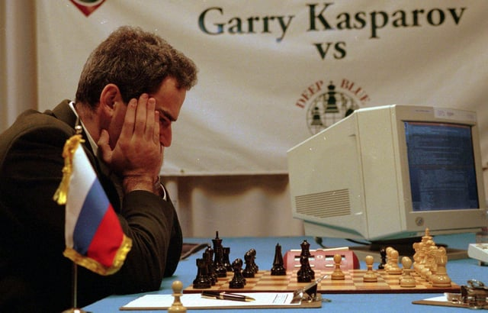
Introduction to Minimax
1928 – John von Neumann first mathematically proved minimax as a viable optimal algorithm for two player, zero-sum games to either minimize or maximize one’s strategy
1944 – John von Neumann and Oskar Morgenstern published “Theory of Games and Economic behavior
1977 – IBM’s Deep Thought algorithm, rooted in minimax, defeated the world chess champion Garry Kasparov

Slide 39
Minimax Algorithm Explanation
Minimax is a decision rule used in to maximize possible losses or wins in any scenario
Objective:
Minimize the possible loss for a worst-case scenario
Maximizing the minimum gain
Key concepts:
Maximizer: Player trying to maximize their score
Minimizer: player trying to minimize their score
Game tree: a tree structure representing all possible moves in a game

Slide 40
Minimax Algorithm Functionality
Generate the game tree to a specified depth
Assign scores to terminal nodes based on the game state
Propagate score back up the tree:
The maximizer will select the maximum value
Minimizer will select the minimum value

Slide 41
Minimax Graphics
ADD PICTURES HERE

Slide 42

Coding Minimax

Slide 43

Play against Minimax! Challenge: Win

Slide 44

15 Minute Debugging Break

Slide 45
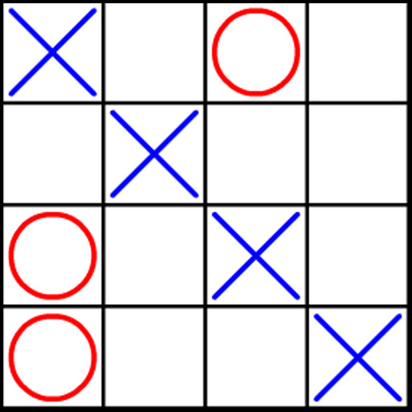
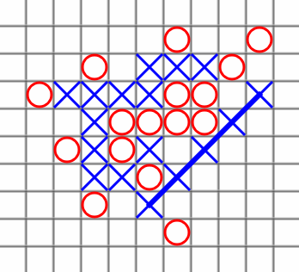
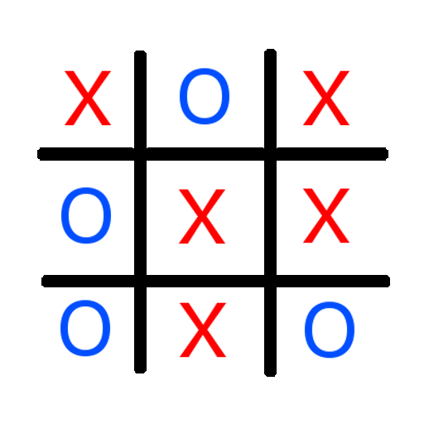
Drawbacks of Using Expert Data
Exclusively using expert algorithms and/or data can lead to scalability issues
Encountering new unaccounted for scenarios may exceed the capacity of a predefined algorithm

Slide 46
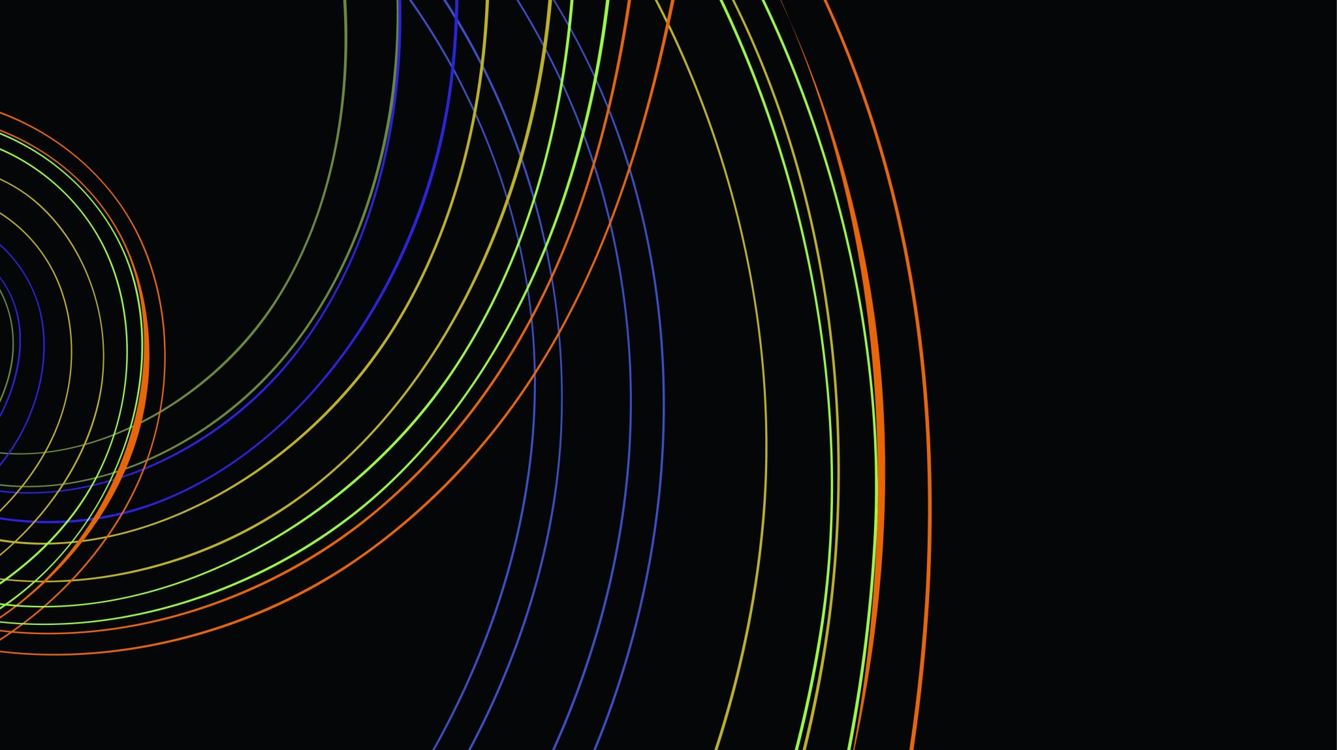
Please Welcome William!

Slide 47

Thank you, William!

Slide 48
Recap of Day 1, What We Learned
Q-Learning Fundamentals
Update Q-Learning Rule
Reward Shaping
Expert Data and Algorithms
Minimax Algorithm
Reinforcement Learning Applications

Slide 49
Looking Ahead, A Glimpse into Day 2
Advancing Reinforcement Learning
Introduction to Deep Learning
Introduction to Deep Q-Learning
Deep Q Networks (DQNs)
Combining DQNs with Expert Data
Deep Q-Learning from Demonstrations

Slide 50
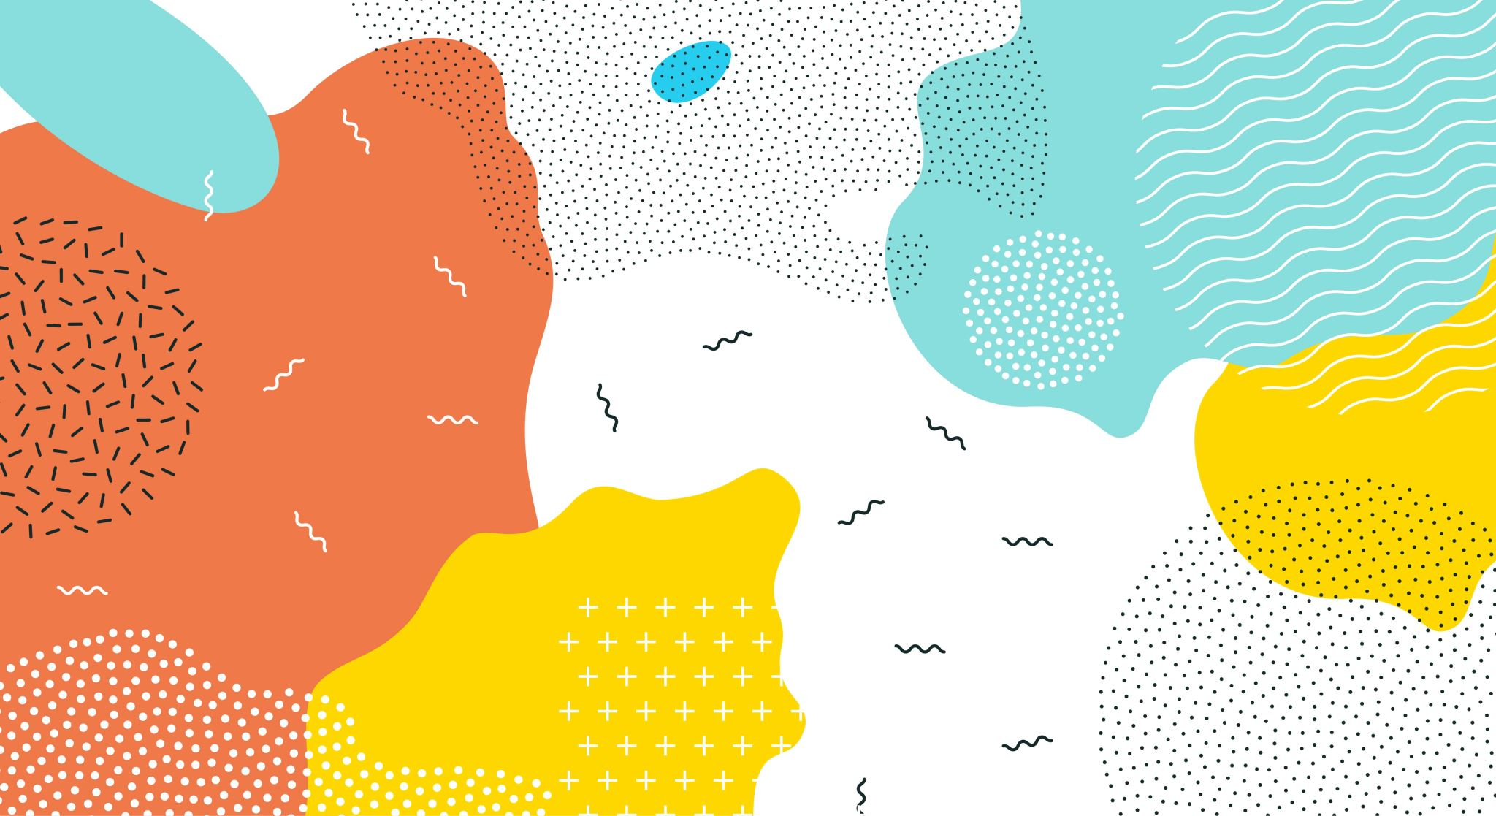
End of Day 1

Slide 51

Welcome to Day 2 We Will Begin Shortly

Slide 52
Please Load Day 1’s Work!
Ensure your entire environment is set up properly
Install Python 3.7 or Higher
Install Torch to Python 3.7 or higher
Load Yesterday's GiitHub Repository
Download an IDE ready to use that can interpret Python 3.7 or higher
Ensure you have admin rights on your machine and can download packages onto it
Check the outlets at your table work (if needed for computer charging, etc.)
We Will Begin Shortly

Slide 53
Yesterday we….
Walked through the fundamentals of Q-Learning
Learned how to apply Q-Learning with Q-Tables
Discussed drawbacks of basic Q-Learning
Explored Expert Algorithms and data such as Minimax
Expressed the Drawbacks of Minimax
Communicated the Drawbacks of Using expert data only

Slide 54
Today We Will Discuss…
Advancing Reinforcement Learning
Introduction to Deep Learning
Introduction to Deep Q-Learning
Deep Q Networks (DQNs)
Combining DQNs with Expert Data
Deep Q-Learning from Demonstrations

Slide 55
Limitations from Q-Learning and Expert Data
Basic Q-Learning converges to an optimal algorithm based on experience
Without enough experience, models can often make suboptimal moves
Exploration vs. Exploitation can be a huge hindrance for making optimal decision making
Minimax can only make optimal moves based on predefined conditions
Using expert data form decisions in foreign environments can lead to suboptimal decision making
ADD PICTURES HERE

Slide 56
Examples of Basic Q-Learning Drawbacks
ADD PICTURE HERE

Slide 57

Welcome Jo Jabour!

Slide 58

Thank You Jo Jabour!

Slide 59
Early Foundations of Deep Learning
1943 – McCulloch and Pits propose the first artificial neuron, building the foundation for neural networks
1957 – Frank Rosenblatt develops the first artificial neural network capable of learning
1986 – Geoffrey Hinton, David Rumelhart, and Ronald J Williams first popularize backpropagation for multilayer neural networks
2010s – computer vision, natural language processing, and speech recognition all use Deep Learning at their core today

Slide 60
What are Neural Networks?
Neural networks are composed of layers of interconnected nodes (or neurons) that transform input data through learned weights
ADD GRAPHIC

Slide 61
What are Deep Networks?
A neural network with multiple hidden layers,

